Slide 1
SELF-SERVICE BIA
P.RAJESH
Dept of E.C.E
JNTUA CE Anantapur

Slide 2
Business Intelligence:
With sustaining changes and complexion in the business environment, all companies are forced to make decisions faster due to the changing conditions under pressures.
All these activities related to decision making require considerable amounts of relevant data, information, knowledge and wisdom. And all processes within the framework must be done efficient and effective and usually these processes need computerized support.Nowadays, organizations are in strong need of effective decision making.
To respond to this demand, vendors started to create enterprise-wide systems with the additional visualization, alerts and performance measurement capabilities.
These kinds of products or services are under the term of Business Intelligence

Slide 3
History of Business Intelligence:
The term Business Intelligence was proposed by Howard Dresner from Gartner Group in year 1996.
That time Business Intelligence was defined as the technologies and applications which consist of data warehouse or data mart, query reports, data analysis, data mining and data backup. And the purpose of Business Intelligence is to help corporate decision-making.
Hans Peter Luhn (1958, 314), a researcher from IBM, proposed that BI is “the ability to apprehend the interrelationships of presented facts in such a way as to guide action towards a desired goal.”
The Management Information System (MIS) reporting system of 1970can be considered as the root of the modern BI term.
During the 1980s, the Executive Information System(EIS) appeared in public, which expanded the computerized support to top-level management. What’s more, some of the features such as ad hoc reporting, forecasting and prediction, trend analysis and critical success factors (CSFs) of EIS are also under the umbrella of BI.
From the middle of 2000s, the evolution of BI starts, varieties of tools and techniques are introduced into this field which makes the modern BI systems have very powerful capabilities.

Slide 4
Definition of Business Intelligence:
“Business Intelligence (BI) is an umbrella term that combines architectures, tools, databases, analytical tools, applications and methodologies.”
As there is no uniform definition of Business Intelligence at present, it can mean different things to different people.
Business Intelligence is the way how organizations or companies use modern technologies to collect, manage and analyze business data and information. And the objectives of Business Intelligence are to gain and cumulate business knowledge and insights, to make better business decisions, to make business operations more effective, to improve business processes, to promote business performances and to enhance competence advantages in the market.

Slide 5
Architecture of general Business Intelligence
BI architecture is the framework used to organize different components together and set up the standards and policies for a Business Intelligence solution.
It also includes the technologies and the communication. Architecture plays a vital role in Business Intelligence operation.
focuses on the end-user layer, it is still very important to know the picture of BI architecture in order to understand the concept and applications better.
A five-layered BI architecture proposed by Ong, Siew and Wong. This architecture consists of data source layer, Extract-Transform-Load (ETL) layer, data warehouse layer, end user layer and metadata layer.

Slide 6
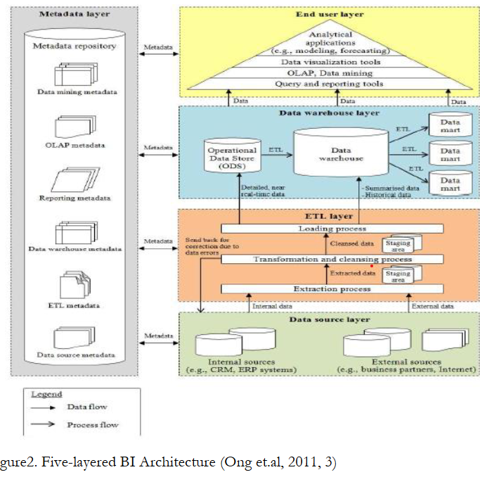

Slide 7
Data Source Layer:-
Two types of data sources are used by BI applications: internal source and external source.
Internal source refers to the data which is obtained and maintained by the sys-tem inside the organization such as Customer Relationship Management system (CRM) and Enterprise Resource Planning system (ERP). Moreover, internal data source also includes all business operation related data such as sales data, customers data etc. All data which are organized outside the organization are called external source for example, data from partners, data from suppliers, information from governments and so on.
The purpose of this layer is to identify the data source. It is very important for an organization to know where all required data are from.
This layer can help not only to increase the reliability of data but also to improve data organizing.

Slide 8
ETL Layer:
There are three main processes included in this layer: extraction, transformation and loading. Extraction is used to read data from different sources both internally or externally.
Transformation is the process that converts the extracted data from its original form into the form which is needed. Loading process is defined to put data into data warehouse.
The purpose of ETL layer is to guarantee that all extracted data are cleansed and are converted into right form and the data loads into target warehouse.

Slide 9
Data Warehouse Layer:
There are three components in data warehouse layer.
First of all, operational data store (ODS) is used to integrate data and load them into data ware-house.
ODS operates as a short-term memory since the data in ODS is updated frequently.
The second component is data warehouse. It is one of the most significant compo-nents in the architecture.
Data warehouse is a central storage of structured data. And all data in data warehouse are ready for analytical use.
Unlike ODS, data warehouse is a long-term memory as the data are permanent. Both current and history data are stored in data warehouses. It is a subject-oriented, integrated, time-variant and non-volatile collection of data to support the managements’ decision making process. The last component in this layer is data mart.
Usually, data mart consists of data from one single subject area and it is created directly from the data warehouse.

Slide 10
End User Layer:-
End user layer consists of tools for users from different areas.
In this BI architecture, these tools are grouped in to a pyramid. In the bottom of the pyramid, there are differ-ent query and reporting tools. These query tools allow end users to access data easily and reporting tools aim at producing reports for decision making and management.
Online Analytical Processing (OLAP) and data mining are in the second level of the pyramid. OLAP manages data in the data warehouse layer to allow fast data analysis.
The purpose of OLAP is to provide answers to business requirements. It provides end users a tool to view and analyze data from different area in an efficient way.
Data mining process is a way to identify useful information quickly, which can optimize the performance of OLAP. The third level from bottom of the pyramid is data visualization tools. The dash board is included in this level. It can provide views of business performances for management level use.
Analytical applications are on the top level of the pyramid. These applications provide the capabilities to analyze and to gain insights of business performance.

Slide 11
Metadata Layer :
Metadata is data about data, which defines the structure and meaning for data.
In this architecture, Metadata management is applied to all other four layers. The purpose of this layer is that by using the well-structured metadata, organizations is able to track and monitor the data flow in aBI solution.
Furthermore, it can help to avoid misunderstanding of data.
The Five-layered BI architecture draws a big picture showing how BI solution works.
Data are gathered from both internal and external sources.
Then these sources will be extracted, transformed and loaded into data warehouse for further analytical use.
End users use different tools to analyze the data to meet the business requirements or needs.
All the data are managed by the metadata layer in the architecture.

Slide 12
Role and Significances of Business Intelligence :
Why Business Intelligence gains more and more attention during the past decade? When seeking the reason, it is not difficult to find out that decision makers have to do everything they can to survive in the business world.
Due to the increasing competitions among enterprises in the market and dynamic business environment, decisions must be made in short time based on all available realtime information. However, when look back to those decisions, ineffective or futile solutions can be al-ways found.
There are several issues can cause this situation, not only because of the influence by decision makers own personalities or opinions.
The most significant factor is whether the information provided for decision making is adequate and accurate or not.
The meaning of Business Intelligence is to help the enterprise to dig out useful information from all internal and external data sources in an efficient and effective way in order to make it available to decision makers at any time and from anywhere when needed.

Slide 13
To an organization, Business Intelligence can be used in the following areas:
1.Understand the operation process and situation: Business Intelligence can help the organization to understand its working condition and the driving forces. In addition, it can also help to understand what impact the business operation and what the future trends will be.
2.Measure performance: Business Intelligence can be used to establish the expectation for both the business organization and its employees by tracking and monitoring performances.
3.Improve relationships: Business Intelligence can be integrated with other systems used in the organization.
For example, the integration between Business Intelligence and CRM system can make the data within CRM system be used in more effective way. The integration also allows the data from CRM system to be used in different operation processes for different purposes and the data can be shared inside the organization. The integration can strengthen the customer loyalty. Business Intelligence can integrate the organization’s resources, strengthen the communication within the operations and improve the relation-ships with customers, suppliers etc.

Slide 14
4.Create opportunity:
Companies can gain profits from useful information. And Business Intelligence aims at organizing and managing data which can let the organization find business opportunities in an efficient way. In the era of information, regardless of the scale, every enterprise has to face the rapidly changing market.
Typically, organization makes decisions based on the existing in-formation. This shows information plays a vital role in business world. How to provide right information to right person in right time is what Business Intelligence can do.

Slide 15
Self-service Business Intelligence Compared with Business Intelligence: Self-service Business Intelligence is a new-born BI pattern. Although this approach has not been existed for long term, huge attention has already gained from both vendors and end users. What Self-service Business Intelligences and why it can grow that fast during the past few years,

Slide 16
Definition of Self-service Business Intelligence:
The definition of Self-service Business Intelligence was proposed by Claudia Im hoff and Colin White.
They defined Self-service BI as “the facilities within BI environment that enables BI users to become more self-reliant and less dependent on the IT organization”.
Self-service BIcan also be called Do-It-Yourself BI (DIY-BI), which shows that Self-service BI aims at providing an environment which is easy to access, analyze and share data with less IT dependency and more end-user involvement.
According to Imhoff and Colin, Self-service BI has four key objectives: easier access to source data, easier use of BI tool, easier consumption of BI results and the faster and easier management of data warehouse.

Slide 17
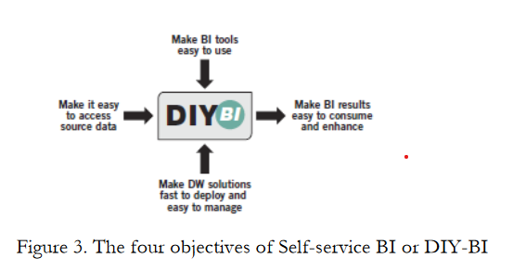

Slide 18
First of all, an easy used tool is the significant factor of Self-service BI.
End users are not IT professionals. They need a tool which is easy to use and can help them to get what they want on their own needs and create reports and analyses. With the easy visual interface, users can become more self-reliant.
Secondly, users would like their reports or analytical results can be understood easily, shared with colleagues and can be shown in different devices. Thus, the second objective is to make BI result easy to consume and enhance, which can make end users more self-sufficient.
In addition, if BI results are easy to consume, organizations will benefit from information interaction.

Slide 19
The third objective focuses on the fast deployment and easy management of data warehouse.
The solution is used to ensure the performance and scalability for data and support easy administration. It also allows end users deploy their own applications according to their specific needs, which can help to raise the end user satisfaction.
The fourth objective is to make data source easy to access. End users can access to data sources in an easier way than traditional BI, which means end users can access to data sources without the assistant from IT professionals. However, it doesn’t mean that IT department doesn’t have control on data source in Self-service BI. IT department will provide all necessary supports when needed. End users can access to different data source quickly which can speed up the whole decision-making process.
To sum up, Self-service BI is a user driven approach which makes the solution less dependent on IT department.

Slide 20
In addition, it is easy to use as the key users of Self-service are business users. Moreover, Self-service BI provides more flexible configurations and easier administration. Finally, a good solution must provide high performance which is also one of the key factors that Self-service BI seeks

Slide 21
Drivers for Self-service BI
BI has gained lots of attention from the business world to help make better decisions in shorter time in past few years which can be seen clearly from the BI market expansion.
However, still millions of organizations haven’t use BI in decision-making process. According to the BI architecture presented in the previous section, we can clearly see that IT professionals play very important role in BI, from data collection to the final analyses and reports. In recent years, there is a change in business and the role of IT.
From the business point of view, with real-time changing in the business environment, they need an easy use solution which can provide qualified up-to date information in short time. The demands of business users are increasing continuously.
On the other hand, in most organization, the role of IT is to maintain and support the use of systems and technologies, which make IT professionals don’t want too many changes in their work. How to balance the business needs and IT becomes one critical issue in BI field. This is the primary driver for Self-service BI. There are also other reasons why Self-service BI is implemented by organizations during the past few years. A survey was carried out by TDWI (The data warehouse Institute) in March 2011.
The survey respondents are from different industries, different areas and different company sizes.

Slide 22
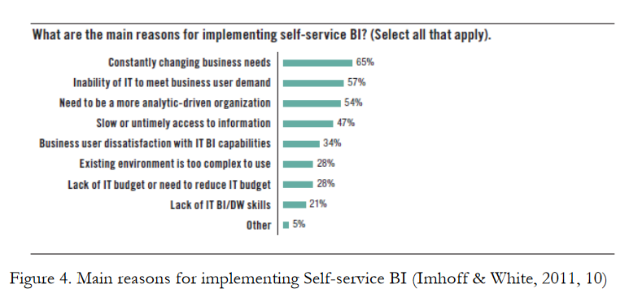

Slide 23
Self-service BI vs. Traditional
BIA l though Self-service BI has lots of benefits that traditional BI doesn’t have, from the author’s point of view, Self-service BI is not a substitution of traditional BI solution.
In fact, Self-service BI and traditional BI support each other in many areas.
In addition, the target users for these two types of BI solution are different.
Self-service BI focuses on business users who have little experience with IT or related knowledge while traditional BI has both business users and IT professionals involved in the solutions.
Self service BI emphasizes on providing an easier tool to use with less IT involvement and usually it is a pre-defined package.
The Self-service BI let business users have the direct access to data source, which enables a better and faster access than traditional way.
In addition, Self-service BI allows end users to create personalized reports and analyses. IT professionals are no longer one of the key users in Self-service BI, IT be-comes a supportive role.
On the other hand, traditional BI is implemented according to the organization’s own needs typically managed by IT professionals or a BI center.
In traditional BI, IT department is not only a supportive role to help business users to understand what kind of data is available, but also one of the key roles in all tasks related to data from extracting to loading.
It is very difficult to say which one is the better option for an organization. If the organization has more advanced and customized business requirements or needs, traditional BI is still the primary option.
If the organization is looking for a more self-reliant and less IT-dependency solution, then Self-service BI will be a better choice. It is also possible for an organization to have both solutions working at the same time.

Slide 24
Microsoft BI Solution:
As a mega vendor, Microsoft also provides BI solution. According to Gartner’s Magic Quadrant 2014 for BI report, Microsoft is one of the leaders in the BI platform market. In this section, the overview of Microsoft BI solution will be introduced and also the frame work of Microsoft BI.
Microsoft aims at providing a BI environment which can improve performances of individual, teams and business units, thus, Microsoft delivers BI tools into different categories which can interact to each other: personal BI, Team BI and organizational BI. (Microsoft, 2008b) With the development of technology and other business and market needs, Microsoft provides also now Self-service BI and cloud solution.
Overall, Microsoft BI consists of SQL Server Integration Services, SQL Server Analysis Services, SQL Server Reporting Services, Performance Point Server, Excel, SharePoint and Office 365 and Power BI. All these tools are used to achieve the following goals, first of all, to provide quality data. Second goal is to gain deeper insight and improve decision-making process and finally to enable organizations carry out agile decisions to meet the corporate goals and strategy. (Microsoft, 2008b)

Slide 25
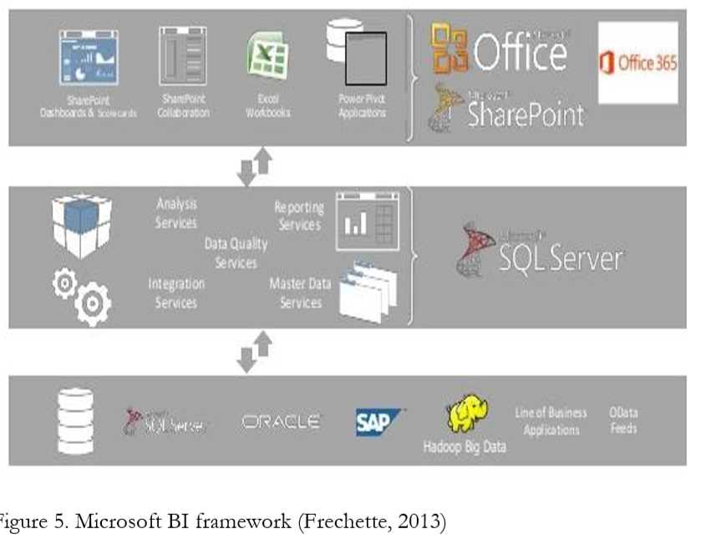
Microsoft BI Framework

Slide 26
There are three main components in Microsoft BI framework:
SQL Server, Office especially Excel and SharePoint.
Each of these play vital roles in the BI suite.
SQL server is used to deploy and manage data from both on-premises and cloud storage. SQL server also provides services for analyzing, reporting, integration, which are the base of Microsoft BI suite.
Second, Excel, which can be used as an end-user tool to enhance data discovery and analysis capabilities.
The last one is the SharePoint, which enable users to collaborate, share all results and manage the usage.
In SharePoint Online, users can get access to reports and information whenever and where ever they want.

Slide 27
Differences between Microsoft traditional BI and Self-service BI
Power BI as a Self-service BI solution, the normal drivers for Self-service BI also apply to it. The most critical issue is the balance between sustained changing in business and IT professionals. In this section, the differences between Microsoft traditional BI solution process and Self-service BI solution process will be presented.
In order to carry out the comparison, let’s assume that now the business professional wants to have a comparison about the sales performances from different branches of the organization. All the sales related data are stored in the branches’ own ERP systems. According to the Microsoft traditional BI architecture, a BI solution process can be divided into different steps.

Slide 28
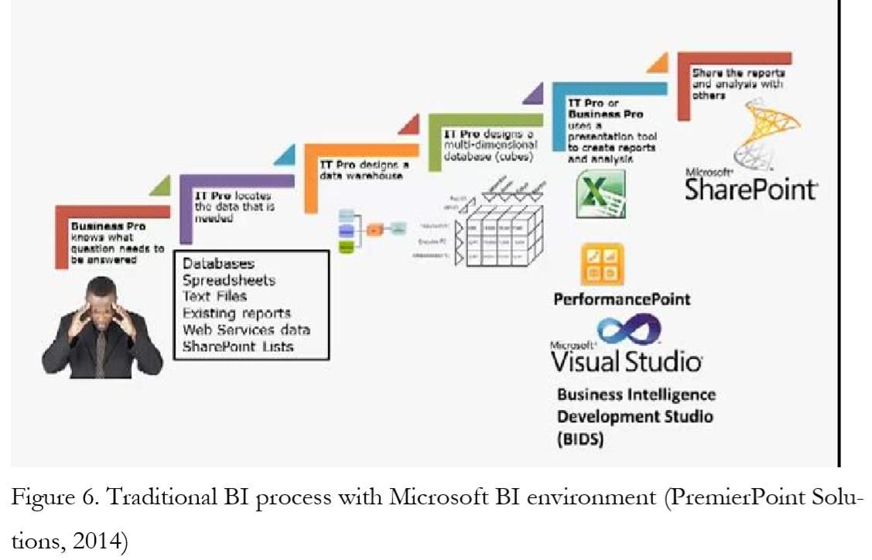

Slide 29
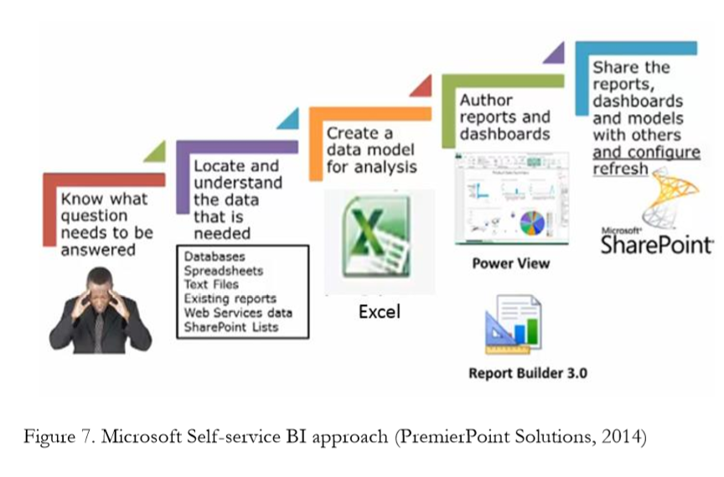

Slide 30
Features and Services
The author starts with the features in Excel, then the Power BI services for Office 365 and ends up the t Power BI Admin center.
Self-service BI Features in Excel
Let’s take a look at the features and services that are included in Power BI. Excel 2013 Professional Plus environment plays a vital role in Microsoft Self-service BI environment.
Excel 2013 Professional Plus can be considered as a very powerful Self-service BI tool because you can build your solution within the platform from access to data source to create the analyses and results.
In Excel 2013 Professional Plus, you can access data from different data sources and manage the data on your own needs. Moreover, you can build your own measures, create reports and analysis by using Self-service BI features in Excel.
The four features: Power Query, Power Pivot, Power View and Power Map provide you all the functionalities and capabilities on data management, data analysis and visualizations. What’s more, except Power Map, the rest features are integrated into Power BI online services.

